Slide 1

Getting started with Benchmark.NET

Slide 2
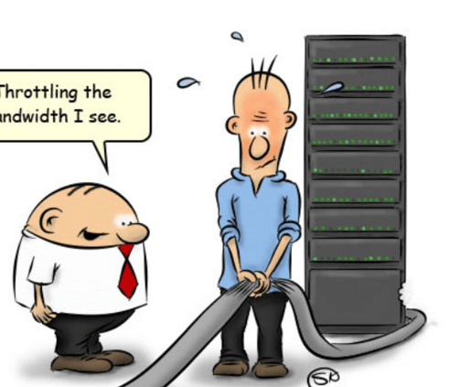
What! Why !
You can easily make a mistake while writing code.
Protect your code from throttling issues
Really easy to design a performance experiment
Compare any environment
Performance difference between processor architectures
Generate colorful reports

Slide 3
Why do Performance Testing?
Ensure applications will perform well under their expected workload.
Three pillars of performance
Speed
Scalability
Stability
Provide stakeholders with information about application regarding speed, stability, and scalability using the generated reports.
FunFact : Only a 5-minute downtime of Google.com (19-Aug-13) is estimated to cost the search giant as much as $545,000 -> 3,87,66,803 Indian Rupee

Slide 4
Noticed Pitfalls
Comparing Strings
Using var a = “”
Arrays and Lists
Dynamic objects
Using deeply nested if{ if{} if{} }
Supressing Exceptions with try{} catch{} without throwing it

Slide 5


Comparing Strings
It is necessary to compare two string variables, ignoring the cases.
I have seen this in most places
str1.ToLower() == str2.ToLower()
Repetitively calling the function ToLower() is a bottleneck in performace.
string.Equals(userName, accountName, StringComparison.OrdinalIgnoreCase);
//Ignoring cases

Slide 6
Using var a = “”
This is not so much a performance improvement as it is a readability improvement, but it still counts as code optimization. Try to replace lines like
If(str ==“”)
With
if (str == string.Empty)

Slide 7
Use && and || operators
When building if statements, simply make sure to use the double-and notation (&&) and/or the double-or notation (||)
Instead of writing deeply nested if statements consider the above operators
if (object1 != null && object1.IsActive)

Slide 8
Avoid Try Catch
Try-Catch statements are meant to catch exceptions that are beyond the programmers control
Using a try statement to keep code "simple" instead of using if statements to avoid error-prone calls makes code incredibly slower. Restructure your source code to require less try statements.

Slide 9
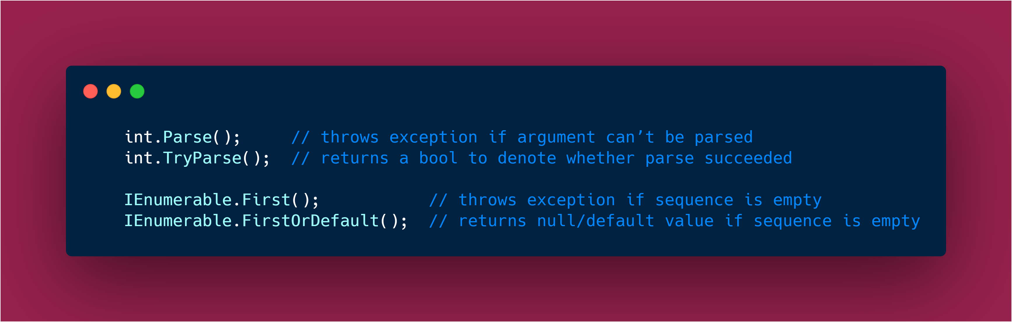
More improvements
Avoid initialization of 10 class in constructor, instead use Dependency Injection.
Use Generics Eg: GetJson<T>
C# is statically typed, never use dynamic except 0.0001% use case.
Clean Code will definitely look and perform better

Slide 10

KISS

Slide 11


